Slide 1
Banking Customers Churn Prediction using Machine Learning Models
DATA 245 – Project Presentation
Professor: Shih Yu. Chang, Ph.D.
San Jose State University
Iqra Bismi, Saniya Lande, Shilpa Shivarudraiah, Janani Ravi Kumar
(Project Group 6)

Slide 2

Introduction and Background
Churn is the measure of how many customers stop using the product or service – can be based on actual usage or failure to renew.
Churn rate is the key indicator for any business. Improving the customer retention rate for existing customers by just 5% can improve a company’s profitability by 25-95%.(Study by Bain and company)
A bank is a financial institution licensed to receive deposits and make loans. Banks may also provide financial services such as wealth management, currency exchange.
Some of the bank customers in due course will stop their utilization or end their subscription; this could be because they switched to a competitor, no longer need the bank services, they’re unhappy with their user experience, or they can no longer afford the cost.
It is much more expensive to sign in a new client than keeping an existing one and the fact that more profits are produced through long-term customers.
Many competitive companies have noticed that a key approach for survival within the industry is to retain existing customers. This leads to the importance of churn management in organizations such as a bank.
DATA245 Final Presentation
Banking Customers Churn Prediction using Machine Learning Models

Slide 3
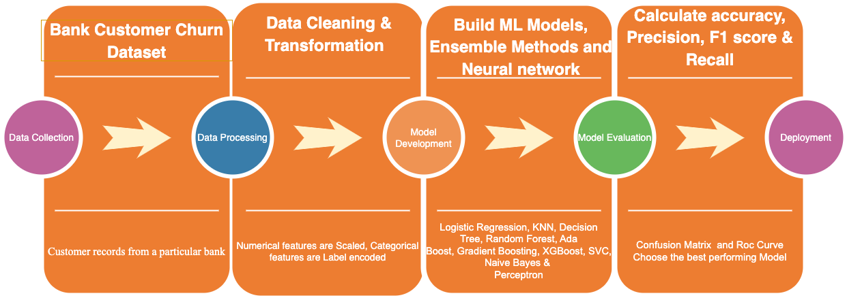

Objective
Identify and visualize which factors contribute to customer churn.
Build a prediction model using machine learning that will classify if a customer is going to churn or not.
Based on different models’ performance choose a model that will be able to attach a probability to the churn which makes it easier for the customer service team to target those customers to prevent churn.
DATA245 Final Presentation
Banking Customers Churn Prediction using Machine Learning Models

Slide 4
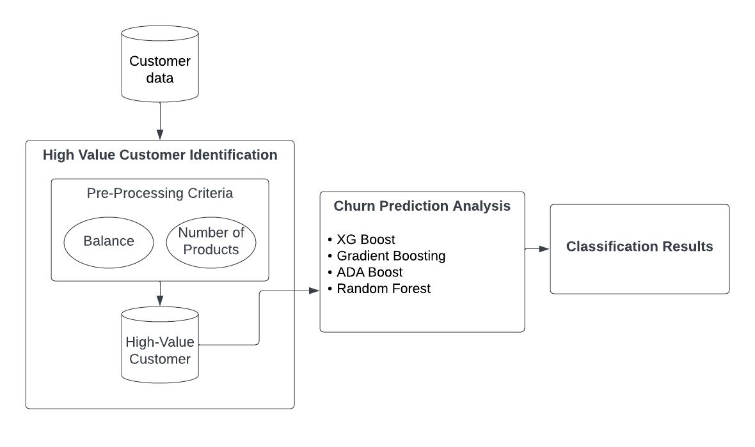
Architecture
DATA245 Final Presentation
Banking Customers Churn Prediction using Machine Learning Models
Notes:
The architecture for the customer churn prediction in banking service is as shown here. The customer data stored in the bank database is used to identify the high value customers using certain features like the balance the customer holds or the number of products the customer has, etc. The data for these high value customers is stored in the bank database which is further used for churn prediction analysis where various various ml models are implemented. We will be using logistic regression, K-means clustering, KNN, random forest. The results are then evaluated and the best model for predicting customer churn is selected.

Slide 5
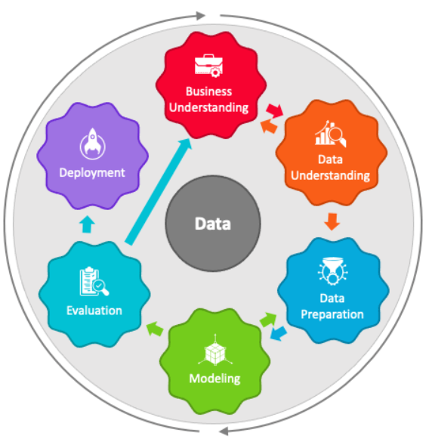
CRISP-DM
Percentage of people churning
Features leading to churn
Effect of Demographics on the churn rate
Data cleaning
Data exploration
Use the best model for real life applications
Normalization
Feature Engineering
Feature Selection
Evaluation metrics
Accuracy score
F1-score
Recall
Precision
Customer Churn Prediction using
XG Boost
ADA Boost
Gradient Boosting
Random Forest
DATA245 Final Presentation
Banking Customers Churn Prediction using Machine Learning Models
Notes:
We will follow the CRISP-DM methodology for our analysis. The first step is business understnaidng. We would like to analyse the percentage of people churning, what Features are leading customers to churn, how the demographics like age, gender, etc affect the customer churn rate.
Next phase is data understanding where we will be exploring the dataset available to us using visualisations, Data wrangling as well as identifying the important features for our analysis.
Data Preparation phase , we would be doing some feature engineering such as normisalisation, identifying corelations between the features, feature scaling, etc.
Once the data is ready and the important features have been identified, we would be applying ML models like Logistic regression, K-means clustering, KNN and Random Forest for predicting the customer churn.
Evauation phase will ivolve creating classification report that shows various performance metrics like F1 score, accuracy score, recall, precision for each model and to identify which model performs the best.
Last phase is deployment wherein the best suitable model can be then applied to real-life scenarios.

Slide 6
ABT for banking customer data
Collected data from Kaggle website.
Dataset has 7 Continuous and 6 Categorical descriptive feature.
Banking Churn Prediction
Customer Details
Product Details
Interaction Variables
Transaction Details
Churn/Exited
Customer ID
NumOfProducts
Balance
(Target Feature)
Credit Score
Surname
HasCrCard
Estimated Salary
Gender
Age
Tenure
IsActiveMemeber
Geography
DATA245 Final Presentation
Banking Customers Churn Prediction using Machine Learning Models

Slide 7
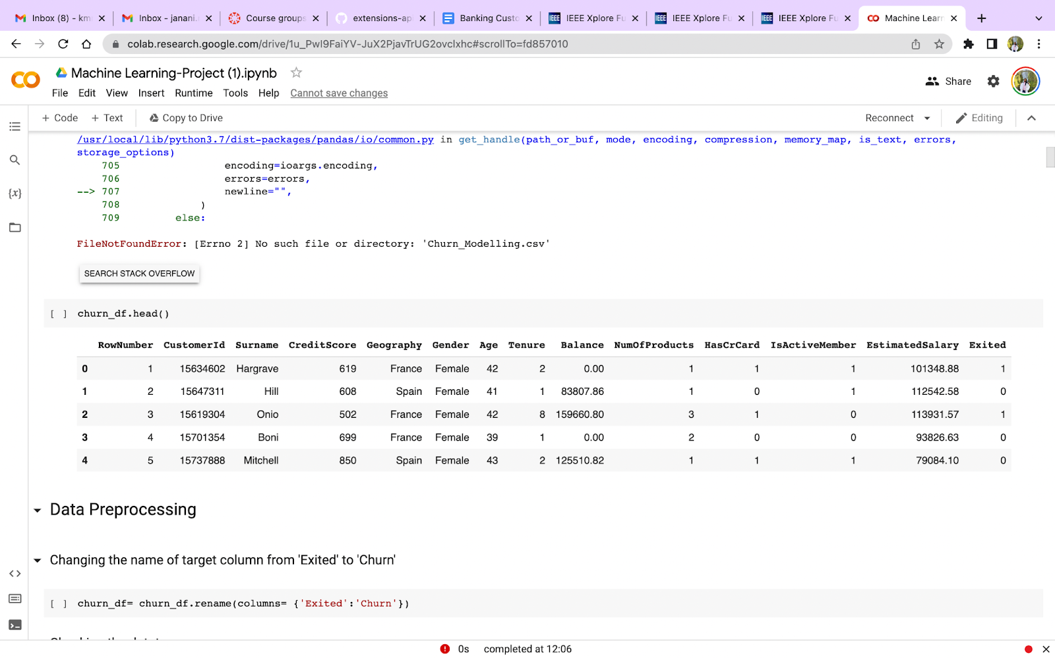
Sample data
Data source – Kaggle
10000 bank customer records and 13 features.
DATA245 Final Presentation
Banking Customers Churn Prediction using Machine Learning Models

Slide 8
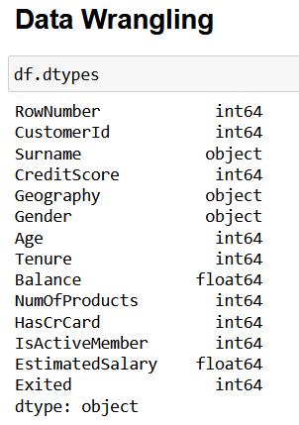
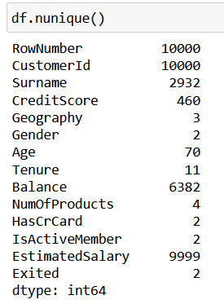
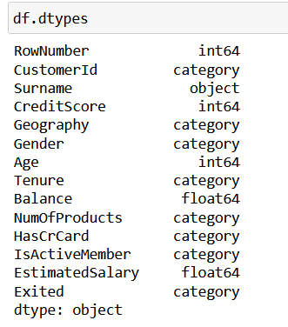
Data Types of Features
Check Data-Type of features
Check levels for features
Convert to categorical features
DATA245 Final Presentation
Banking Customers Churn Prediction using Machine Learning Models
Notes:
Initially, we will check the data type and the unique values present for each feature. Some features like Number of Products, Is Active member, Has Credit card have less number of unique values but they are of integer datatype. So these features having less distinct values are identified and are converted into categorical features which can be seen from the third figure.

Slide 9
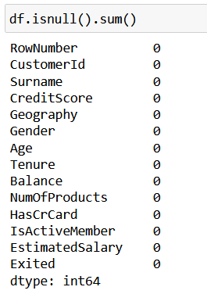
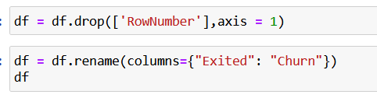
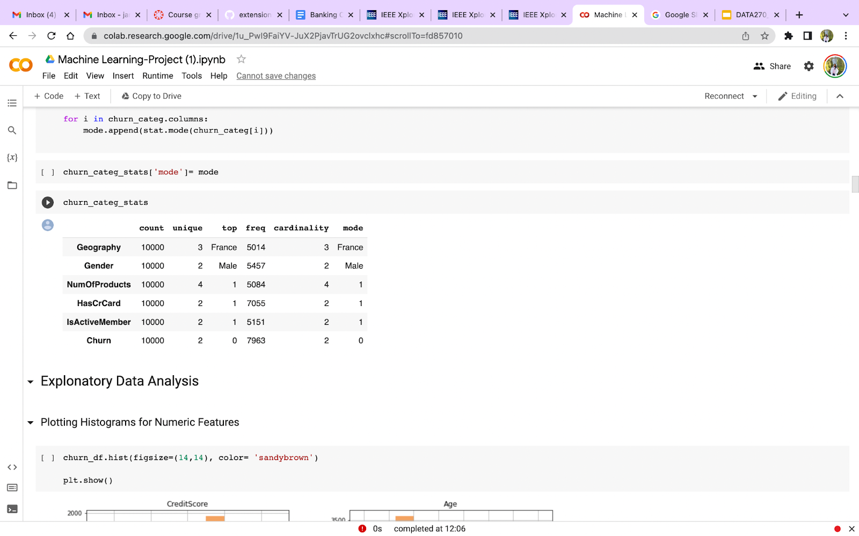
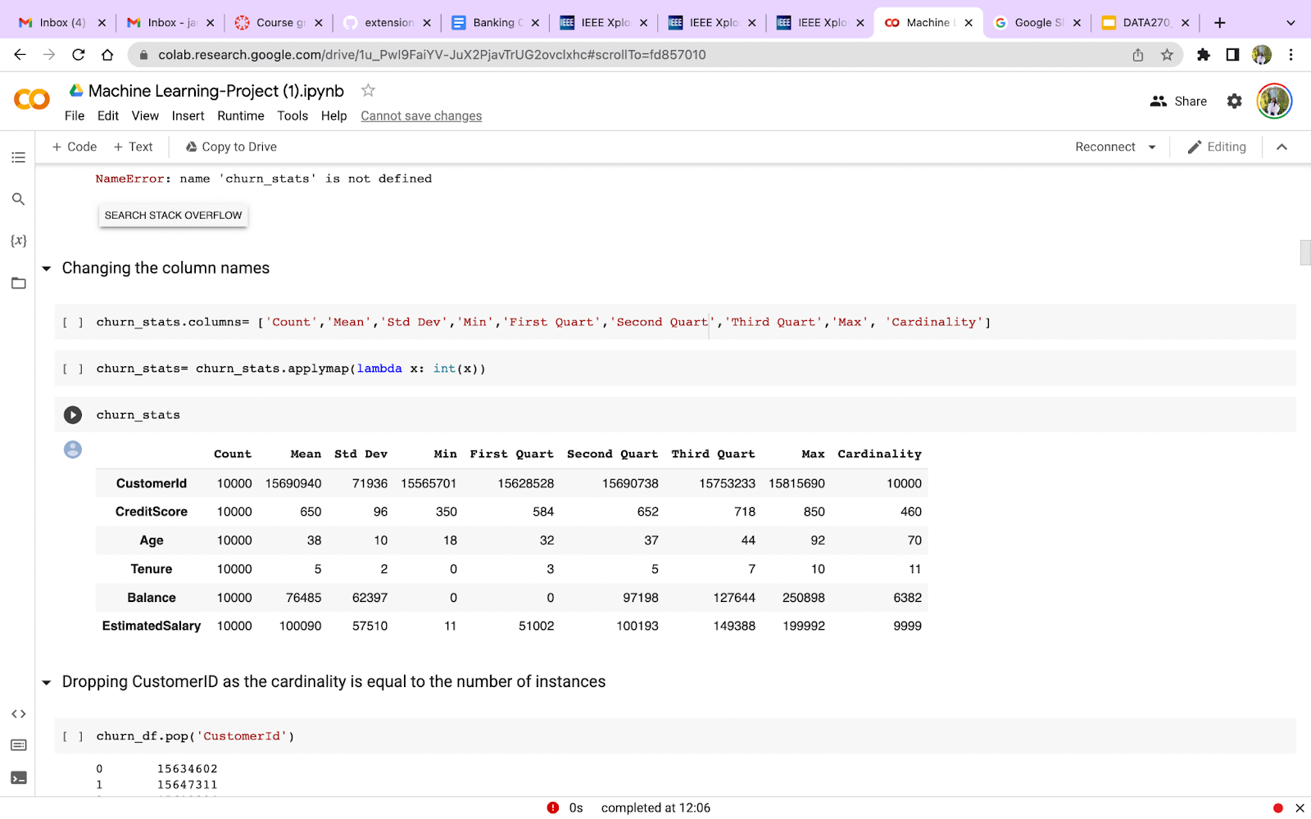
Data Wrangling
Check the null values
Data Cleaning
Describe categorical features
Check for duplicate data
Describe continuous features
DATA245 Final Presentation
Banking Customers Churn Prediction using Machine Learning Models
Notes:
We will then start with data pre-processing step wherein the null values are checked. We can see that there are no null values in our dataset. Next, we drop the feature named row_number because it is not relevant for our analysis . We also rename the target feature from exited to Churn for better understanding. We then check for any duplicate values. We don’t have any duplicates in our dataset. The next stpes will be explained by Iqra.

Slide 10
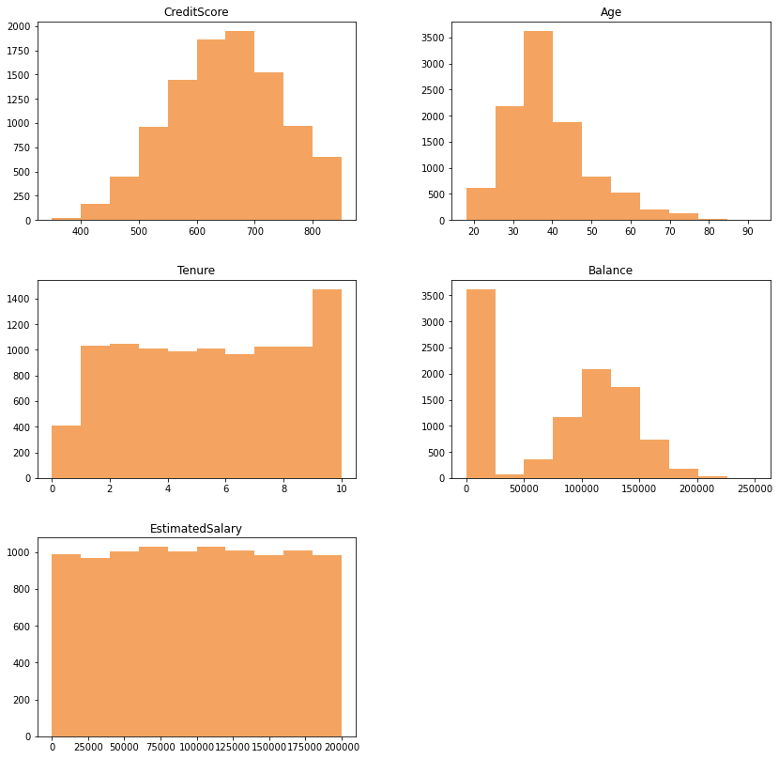
Exploratory Data Analysis
Distribution of Continuous Variables
Age, Credit Score – Normal
Estimated Salary – Uniform distribution
DATA245 Final Presentation
Banking Customers Churn Prediction using Machine Learning Models

Slide 11
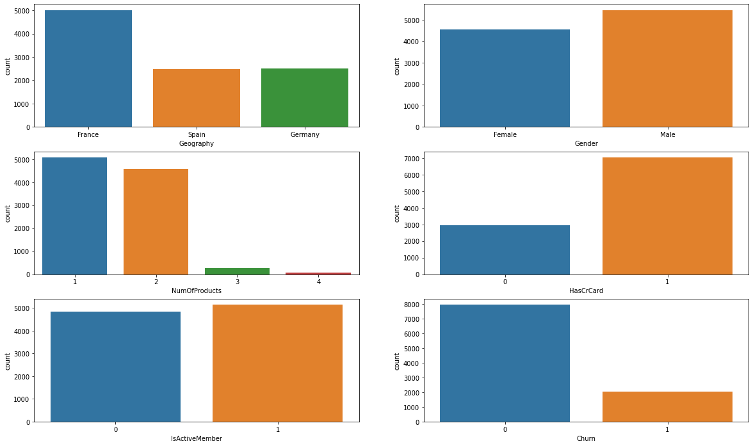
Exploratory Data Analysis
Count Plot of Categorical features
DATA245 Final Presentation
Banking Customers Churn Prediction using Machine Learning Models

Slide 12
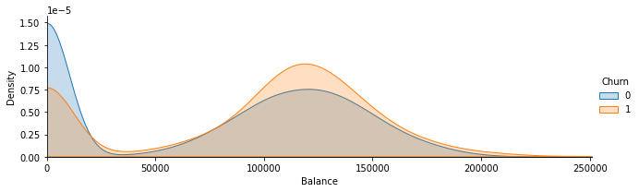
Exploratory Data Analysis
KDE plot - Probability Density of the continuous variable, Balance amount of the customers in the bank
Ranges from 0 to 250000
DATA245 Final Presentation
Banking Customers Churn Prediction using Machine Learning Models

Slide 13
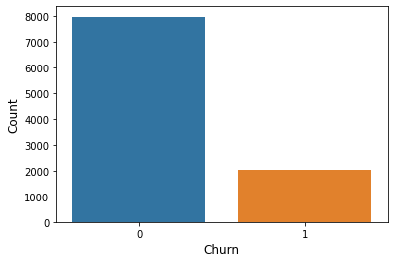
Exploratory Data Analysis
Target Class Balanced or Imbalanced ?
Churn class is imbalanced. Class can be made balanced by:
SMOTE (Over Sampling)
Near Miss Algorithm( Under- Sampling)
By assigning class weights: using the formula, wj=n_samples / (n_classes * n_samplesj)
Stratified K-Fold Cross Validation
DATA245 Final Presentation
Banking Customers Churn Prediction using Machine Learning Models

Slide 14
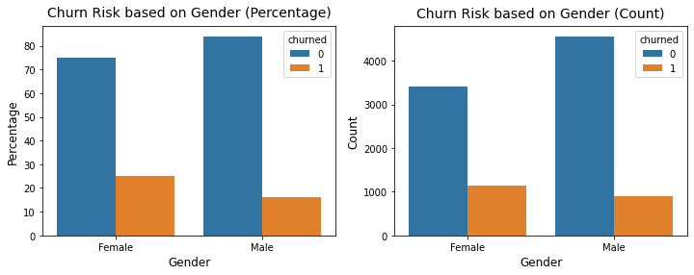
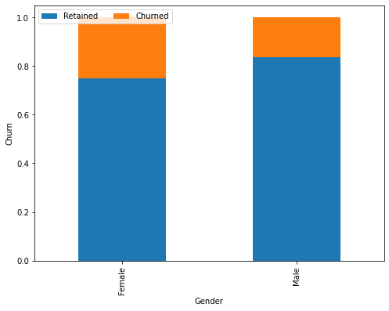
Exploratory Data Analysis
Categorical/ Discrete Variables
Male customers - 55%
Female customers - 45%
Male Churn rate – 17%
Female Churn rate – 25%
Female customers are more likely to churn than male
DATA245 Final Presentation
Banking Customers Churn Prediction using Machine Learning Models

Slide 15
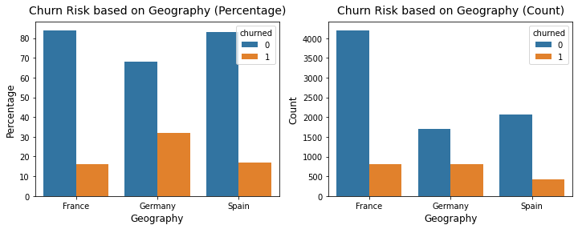
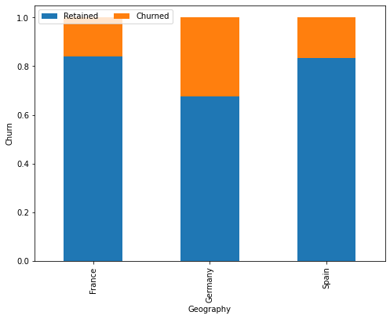
Exploratory Data Analysis
France Churn rate – 16%
Germany Churn rate – 32%
Spain Churn rate – 17%
German customers churned two times more than French and Spanish customers
DATA245 Final Presentation
Banking Customers Churn Prediction using Machine Learning Models

Slide 16
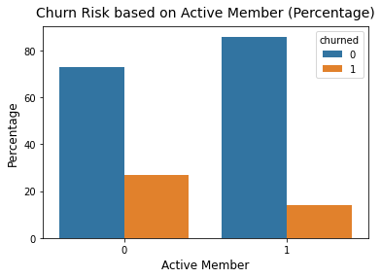
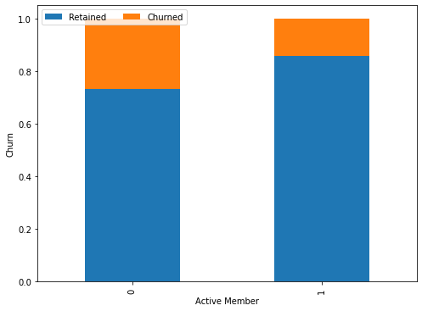
Exploratory Data Analysis
Active Member Churn rate – 14.3%
Inactive Member Churn rate – 26.9%
Inactive members are more likely to leave the bank
DATA245 Final Presentation
Banking Customers Churn Prediction using Machine Learning Models

Slide 17
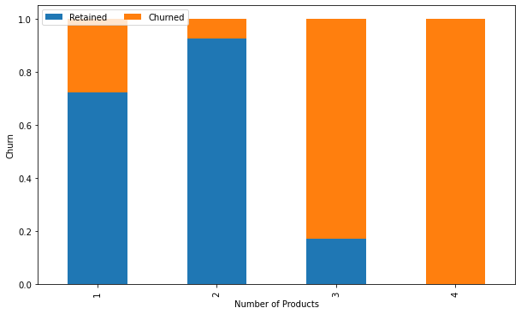
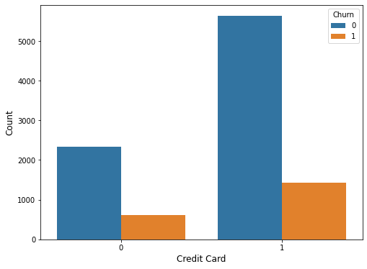
Exploratory Data Analysis
Number of Products = 3, the churn rate is 82%
Number of Products =4, the churn rate is 100%
The customers with Credit card has higher churn rate than customers without credit card
DATA245 Final Presentation
Banking Customers Churn Prediction using Machine Learning Models

Slide 18
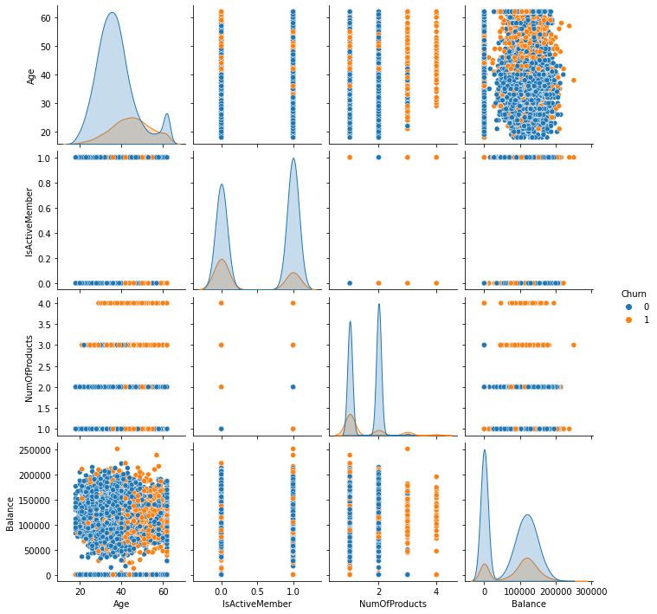
Exploratory Data Analysis
DATA245 Final Presentation
Banking Customers Churn Prediction using Machine Learning Models

Slide 19
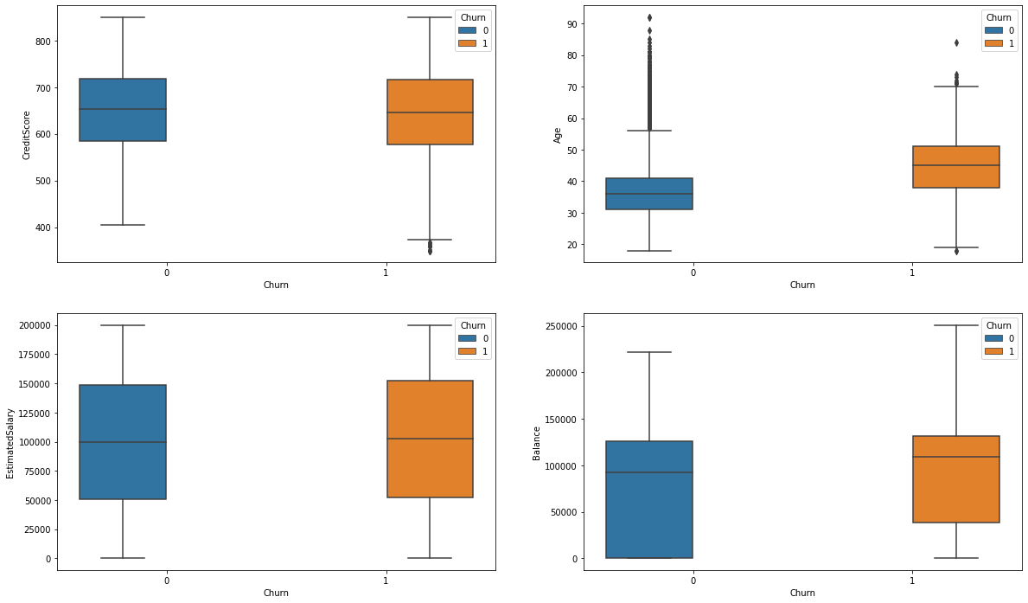
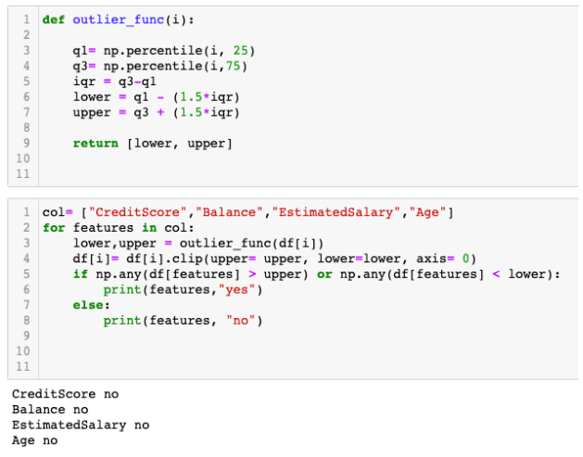
Exploratory Data Analysis
Outlier Analysis
DATA245 Final Presentation
Banking Customers Churn Prediction using Machine Learning Models

Slide 20
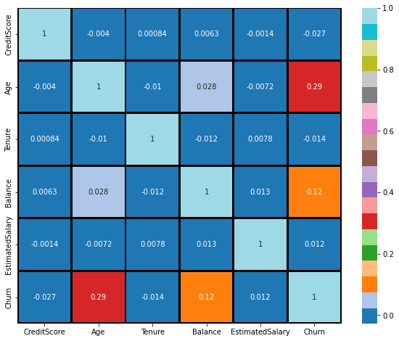
Feature Engineering - Correlation
The goal is to find the trends between variables which when strong can be used later in our Analysis.
DATA245 Final Presentation
Banking Customers Churn Prediction using Machine Learning Models
20

Slide 21
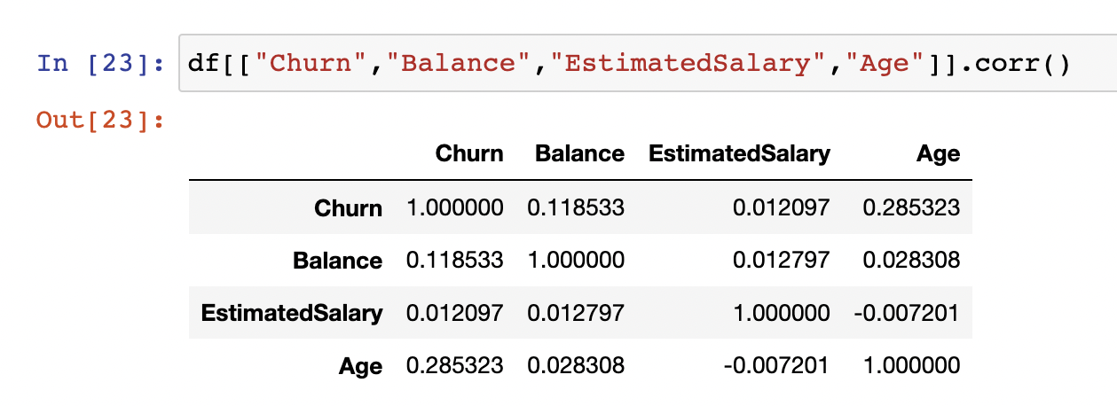
Correlation trends
‘Churn’ field has a mild positive trend with ‘Balance’ and ‘Age’, whereas it has very weak positive trend with ‘EstimatedSalary’.
DATA245 Final Presentation
Banking Customers Churn Prediction using Machine Learning Models
21

Slide 22
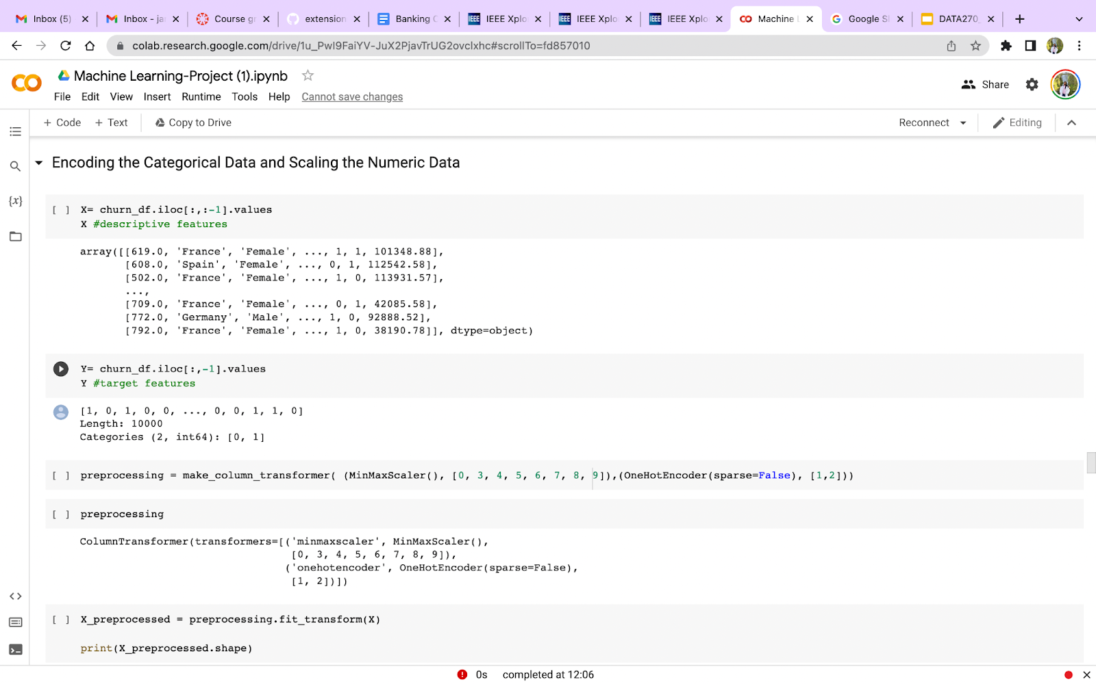
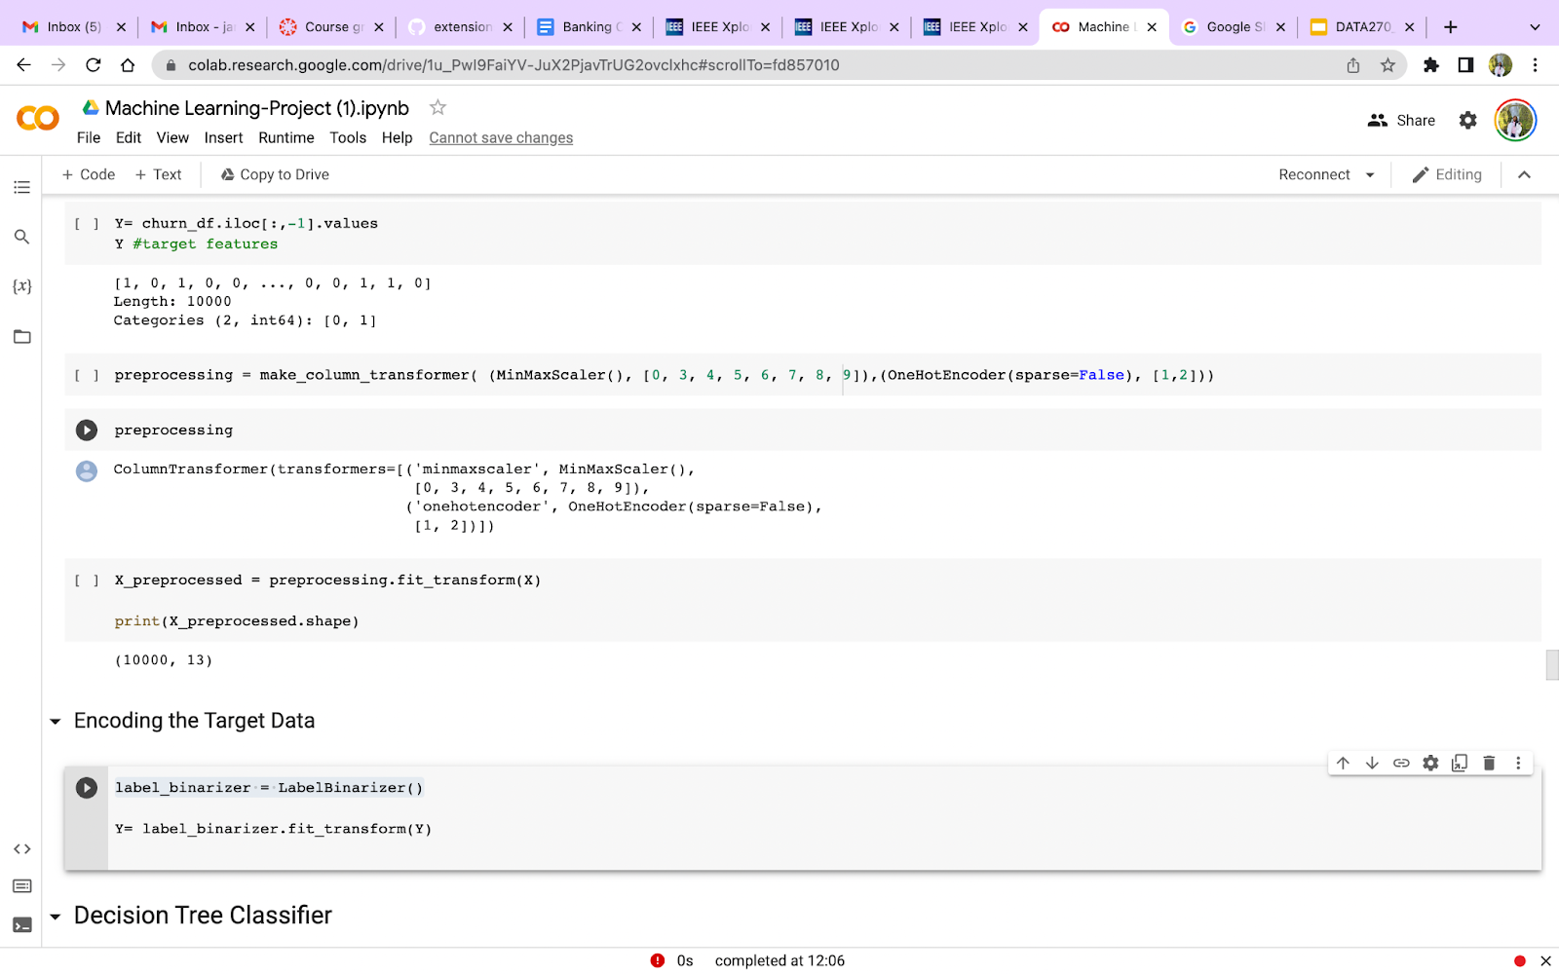
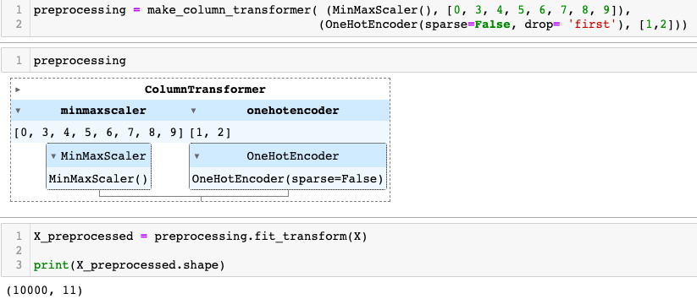

Data Transformation
DATA245 Final Presentation
Banking Customers Churn Prediction using Machine Learning Models
22

Slide 23
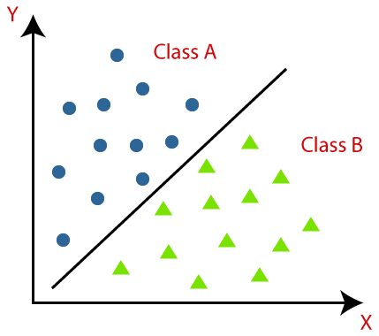
Machine Learning Models
Classification Algorithm – The target feature Churn determines which is categorized into class (0=No,1=Yes)
Random Forest
XG Boost
ADA Boost
Gradient Boosting
DATA245 Final Presentation
Banking Customers Churn Prediction using Machine Learning Models
23

Slide 24
Model Implementation
Split the data into Training and Testing
Created a pipeline for SMOTE and ML Model
Performed Hyper-Parameter Tuning using GridSearchCvwith 5-Fold CV
Compared the performance using Test Data
Trained the model with best parameters
Saved the model using Pickle
Machine Learning Models |  | Advantages
Logistic Regression | KNeighbors Classifier | Ada Boost Classifier
Decision Tree Classifier | Random Forest Classifier | XGBoost Classifier
Gradient Boosting Classifier | Naïve Bayes' Model | Support Vector Classifier
System Configuration
CPU: i7 12700K , 8 performance core,
4 efficiency cores, total 20 threads
DATA245 Final Presentation
Banking Customers Churn Prediction using Machine Learning Models

Slide 25
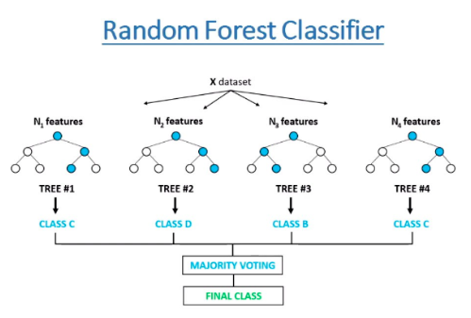
Random Forest Classifier
Random forest model has decision trees as base estimators, bootstrapping and sub-space sampling.
The target variable class is predicted using majority votes criteria.
Advantages
Disadvantages
It reduces overfitting in decision trees and helps to improve the accuracy
It doesn’t suffer from curse of dimensionality
Normalising of data is not required
Due to the ensemble of decision trees, it also suffers interpretability
DATA245 Final Presentation
Banking Customers Churn Prediction using Machine Learning Models

Slide 26
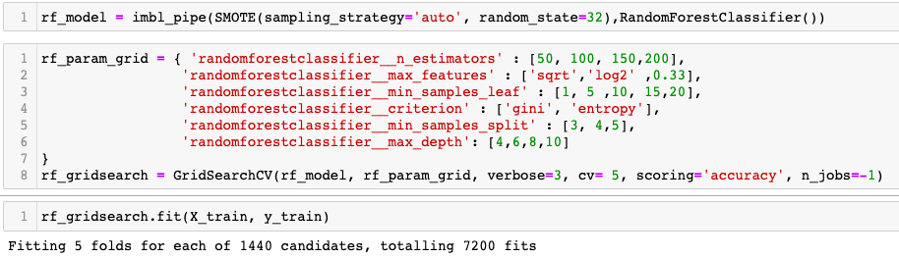
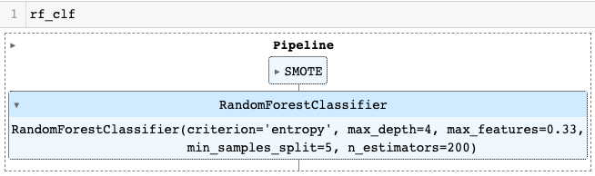
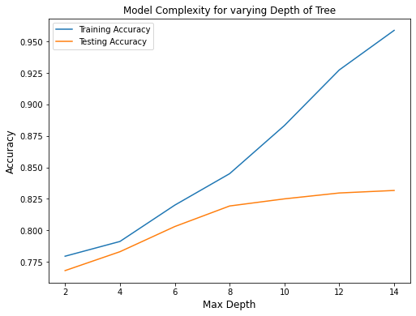
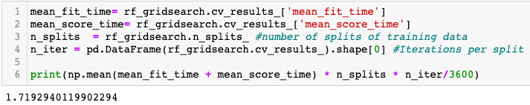
Random Forest Classifier Hyper-Parameter Tuning
Time Taken(Hours)
DATA245 Final Presentation
Banking Customers Churn Prediction using Machine Learning Models

Slide 27
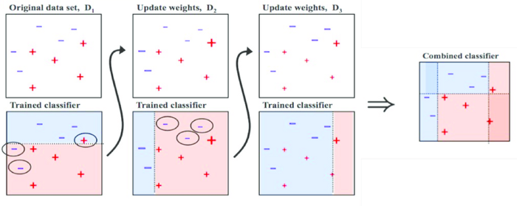
Ada Boost Classifier
Based on concept that weak learners combine to form strong learners
Each model is trained sequentially, and the model tries to correct the wrongly predicted values by predecessor by tweaking the weight
In classifier, the values is predicted based on majority voting
Each estimator has weightage ‘alpha’ in final prediction which depend on the error rate of the estimator
Advantages
Disadvantages
Less prone to overfitting as the input parameters are not jointly optimized
It is sensitive to noisy data and outliers
DATA245 Final Presentation
Banking Customers Churn Prediction using Machine Learning Models

Slide 28
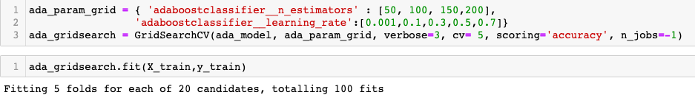
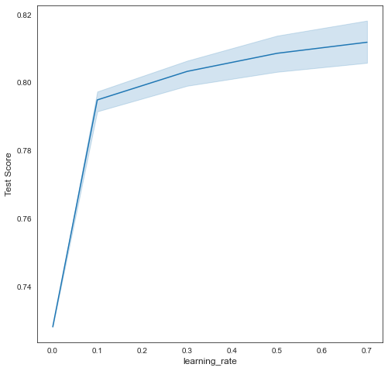
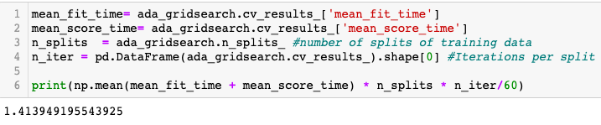
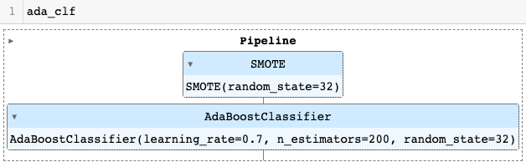
Ada Boost Classifier Hyper-Parameter Tuning
Time Taken(Mins)
DATA245 Final Presentation
Banking Customers Churn Prediction using Machine Learning Models

Slide 29
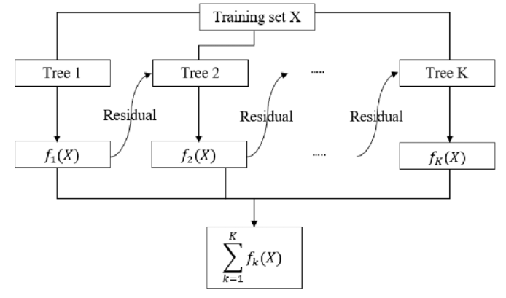
Gradient Boosting Classifier
Each model is trained using residual errors of its predecessor as labels and tries to correct the error produced by predecessor
In classifier, algorithm calculates the log of odds of target variable and the logits are converted into probabilities in order to make the prediction
For each instance, it calculates the residuals i.e., observed values minus the predicted value
Advantages
Disadvantages
Its is flexible as it can optimized on several loss functions
It handles the missing data
Gradient Boosting Models will continue improving to minimize all errors. This can overemphasize outliers and cause overfitting
DATA245 Final Presentation
Banking Customers Churn Prediction using Machine Learning Models

Slide 30
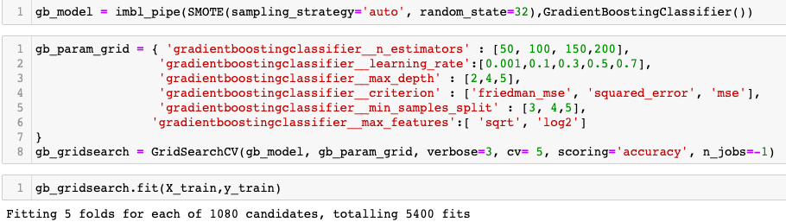
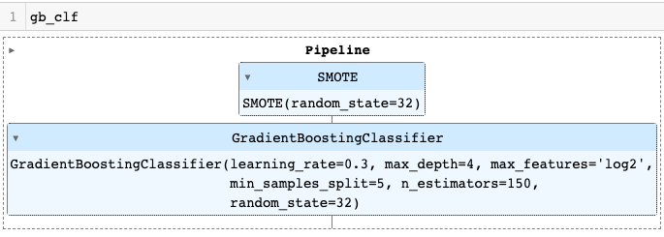
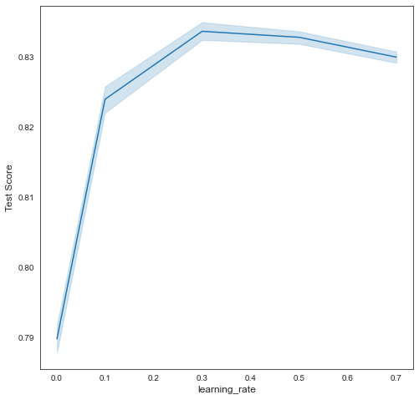
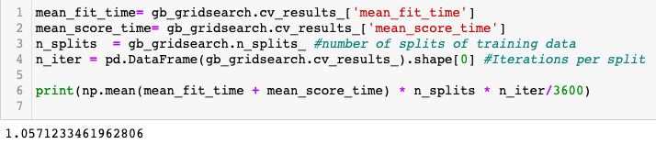
Gradient Boosting Classifier Hyper-Parameter Tuning
Time Taken(Hours)
DATA245 Final Presentation
Banking Customers Churn Prediction using Machine Learning Models

Slide 31
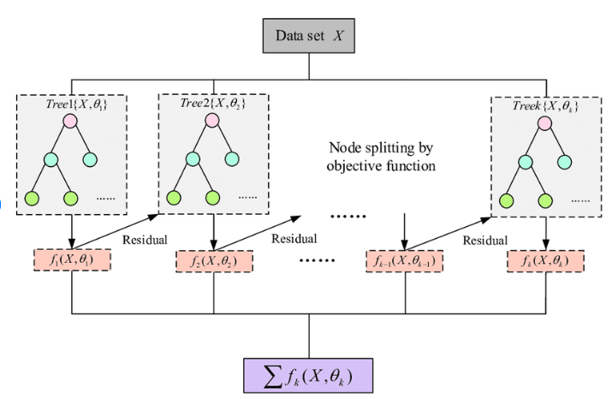
XGBoost Classifier
XGboost model uses regularisation technique along with gradient boosting.
It avoids overfitting of the model by pruning the trees based on similarity score
In XGBoost, when the model fails to predict the anomaly for the first time, it gives more preferences and weightage to it in the upcoming iterations
Advantages
Disadvantages
It prevents overfitting easily
XGBoost performs well on large datasets
XGBoost does not perform so well on sparse and unstructured data
It is very sensitive to outliers as each learner is forced to correct the error produced by previous learner
DATA245 Final Presentation
Banking Customers Churn Prediction using Machine Learning Models

Slide 32
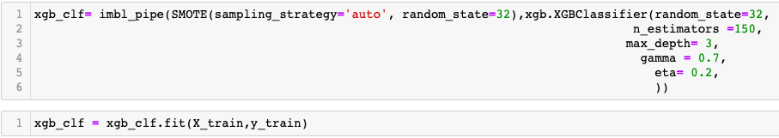
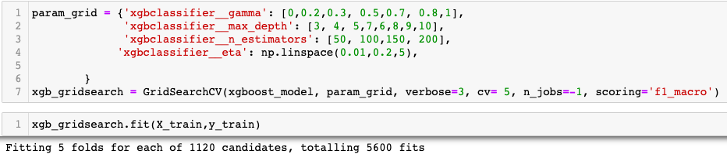


XGBoost Classifier Hyper-Parameter Tuning
Time Taken(Hours)
DATA245 Final Presentation
Banking Customers Churn Prediction using Machine Learning Models

Slide 33
Performance Comparison between Models with and without SMOTE
Machine Learning Model | F1 – Score (With SMOTE) | Accuracy ( With SMOTE) | F1 – Score ( Without SMOTE) | Accuracy ( Without SMOTE)
Logistic Regression | 49.0 % | 71% | 34.0 % | 82.0 %
KNN | 50.0 % | 78 % | 39.0 % | 82.0%
Decision Tree | 57.99% | 81% | 57.99 % | 85.0 %
Random Forest | 59.0 % | 82% | 56.9 % | 86.0 %
Ada Boost | 60.0 % | 82% | 56.01 % | 86.0 %
Gradient Boosting | 61.0 % | 84% | 59.0 % | 86.0 %
XGBoost | 61.0 % | 85% | 59.0 % | 86.0 %
SVC | 54.0 % | 77% | 0 | 80.0 %
Gaussian Naive Bayes | 47.0 % | 69% | 43.0 % | 81.0 %
Perceptron | 39.0 % | 62% | 22.0 % | 76.0 %
DATA245 Final Presentation
Banking Customers Churn Prediction using Machine Learning Models

Slide 34




Confusion Matrix and ROC-AUC Curve for Top Performing Models
DATA245 Final Presentation
Banking Customers Churn Prediction using Machine Learning Models

Slide 35




Confusion Matrix and ROC-AUC Curve for Top Performing Models
DATA245 Final Presentation
Banking Customers Churn Prediction using Machine Learning Models

Slide 36



Model Explanation
Random Forest Feature Importance
Feature Importance using SHAP
HasCrCard Feature is least relevant in Random Forest Feature importance and in SHAP
DATA245 Final Presentation
Banking Customers Churn Prediction using Machine Learning Models

Slide 37


Model Explanation
Recall for different models with all features and relevant features
F1_Score for different models with all features and relevant features
DATA245 Final Presentation
Banking Customers Churn Prediction using Machine Learning Models

Slide 38



K-Fold Cross Validation on Ensemble Model
Ensemble Model for Top Performing Models using EnsembleVotingClassifier
Precision | Recall | F1_Score | AUC Score
64% | 60% | 62.31% | 86.68%
Accuracy and Variance using 5 Fold CV on data with relevant Features
DATA245 Final Presentation
Banking Customers Churn Prediction using Machine Learning Models

Slide 39

Comparison between Ensemble and Individual Models
Model | Precision | Recall | F1_Score
Ensemble | 62.88% | 61.81% | 62.32%
RF | 55.23% | 68.48% | 61.13%
ADA | 54.56% | 65.48% | 59.52%
GB | 60.76% | 62.24% | 61.47%
XGB | 63.14% | 61.41% | 61.23%
F1 Score and AUC Score for Ensemble Model is highest, but recall is highest in Random Forest Classifier.
F1 Score in random forest model is approximately close to Ensemble Model
Random Forest is selected as final model
DATA245 Final Presentation
Banking Customers Churn Prediction using Machine Learning Models

Slide 40



Deployment
DATA245 Final Presentation
Banking Customers Churn Prediction using Machine Learning Models

Slide 41


Deployment
Using Spyder and Streamlit to create Web Application which can be used by Bank
Running the Saved Model in Spyder
Defining web application buttons in Streamlit
DATA245 Final Presentation
Banking Customers Churn Prediction using Machine Learning Models

Slide 42



Deployment
Running the saved file on terminal
DATA245 Final Presentation
Banking Customers Churn Prediction using Machine Learning Models

Slide 43

Conclusion
Implemented multiple classifiers to evaluate the performance of each model.
Oversampling technique increased the accuracy of the model.
Predictive model using relevant features had higher accuracy.
Selected Random Forest Classifier as the best model in terms of recall and F1 score.
Created web application which can be used by Bank to find out which customers are likely to leave the bank services.
DATA245 Final Presentation
Banking Customers Churn Prediction using Machine Learning Models

Slide 44

Thank you
Comparative Performance Analysis - Cassandra Vs MongoDB

